Slide 1


Cybersecurity Club
Dr. Hochstetler March 4th, 2024

Slide 2
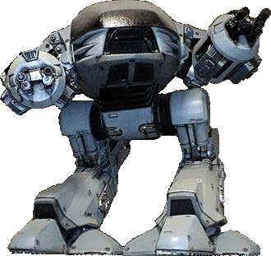
Physical Security

Slide 3
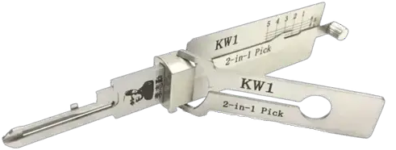
What we are going to cover
What is physical security?
Why bother?
Types of physical security
Real-life example: The White House
HID Attacks
Wi-Fi auditing
Lishi 2-in-1 Lock Pick/Decoder.

Slide 4
What is it?
Physical security is the protection
of personnel, hardware, software, networks and data from physical actions/events that could cause serious loss or damage to an enterprise, agency or institution.
A lock shape with semi-relevant words inside.

Slide 5
Why bother?
Deterrence: The more visible/robust the physical security measures, the less likely it is that an intruder will attempt to breach them.
Prevention: Stop unauthorized access by detecting and stopping intruders before they can enter a building or property.
Protection: Physical security measures can protect valuable assets, such as equipment, data, and personnel.
Compliance: Many industries and organizations are required by law to implement physical security measures to comply with regulations and standards.
Reputation: Compromises will lead to a loss of trust/credibility in a brand or company.

Slide 6
Types of physical security
Physical security falls into two broad categories:
Passive: static barriers
Active: prevent/respond in real-time

Slide 7
Passive physical security
Barriers to entry:
Which could be natural (geographic) features, or artificial structures.
This includes anything that could deter an attack, from outer to inner:
Fencing/walls
Lighting
Strategic landscaping
Security Vestibules (a.k.a. man-traps)
Access Control Systems (door locks, key cards, biometric authentication, etc.)

Slide 8
Active physical security
Measures that are designed to actively prevent/respond to threats in real-time.
This includes items like:
Motion sensors (infrared/ultrasonic)
Video surveillance
Data Loss Prevention software
Anti-Virus software
Meat (security personnel/guard dogs/geese/dolphins/etc.)

Slide 9
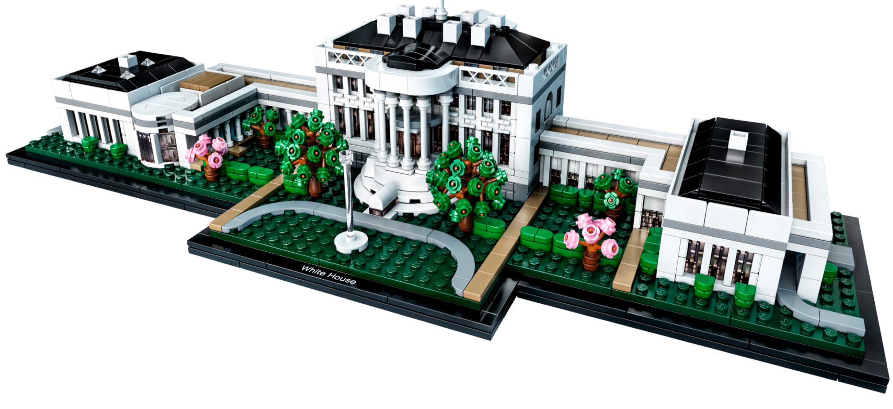
Real-life example: The White House

Slide 10

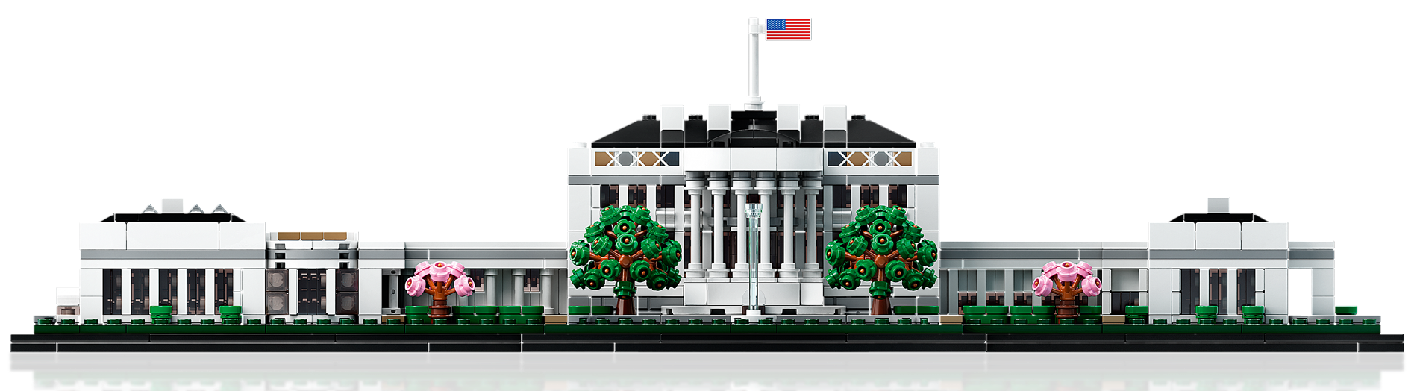


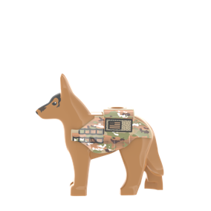
Real-life example: The White House
Active Surveillance
Security Cameras
Security bollards
Security guards/dogs
Keycard Access Control
Motion/vibration/pressure sensors
Iron/steel 2.1m spiked fence

Slide 11
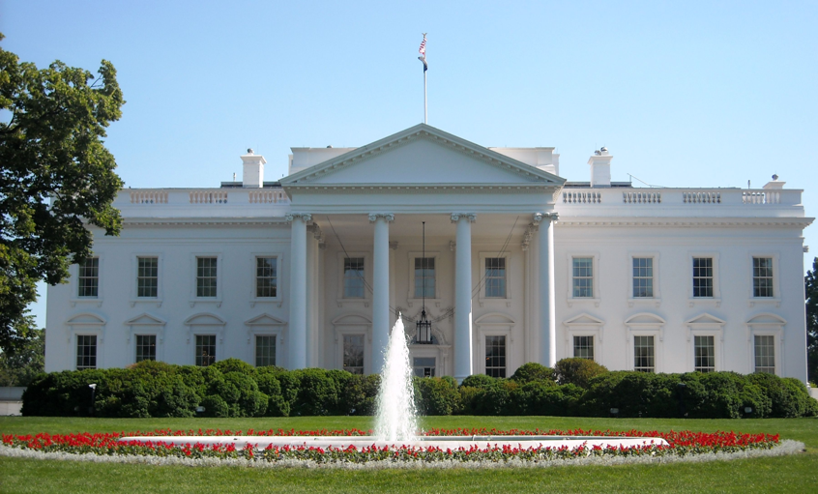
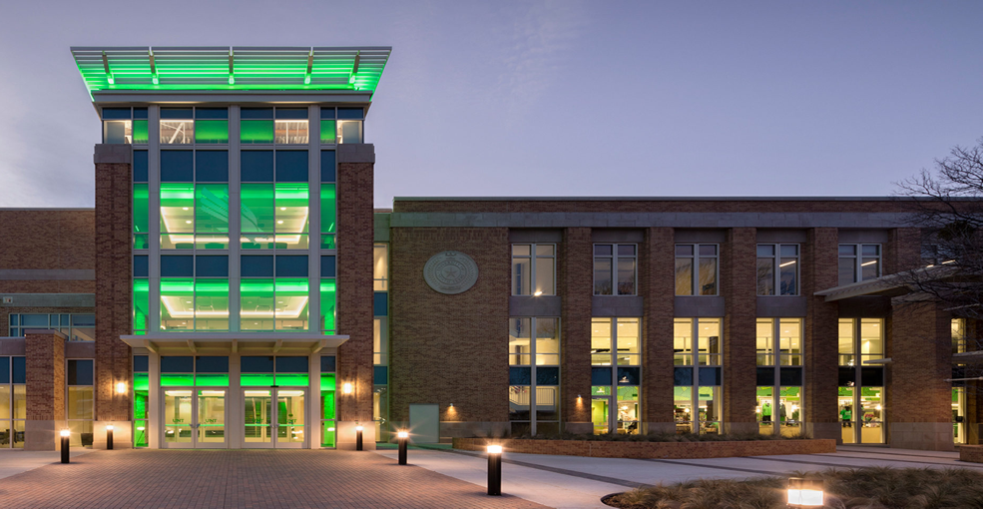
Risk-based approach
Compare these two workplaces
The White House
University Campus

Slide 12
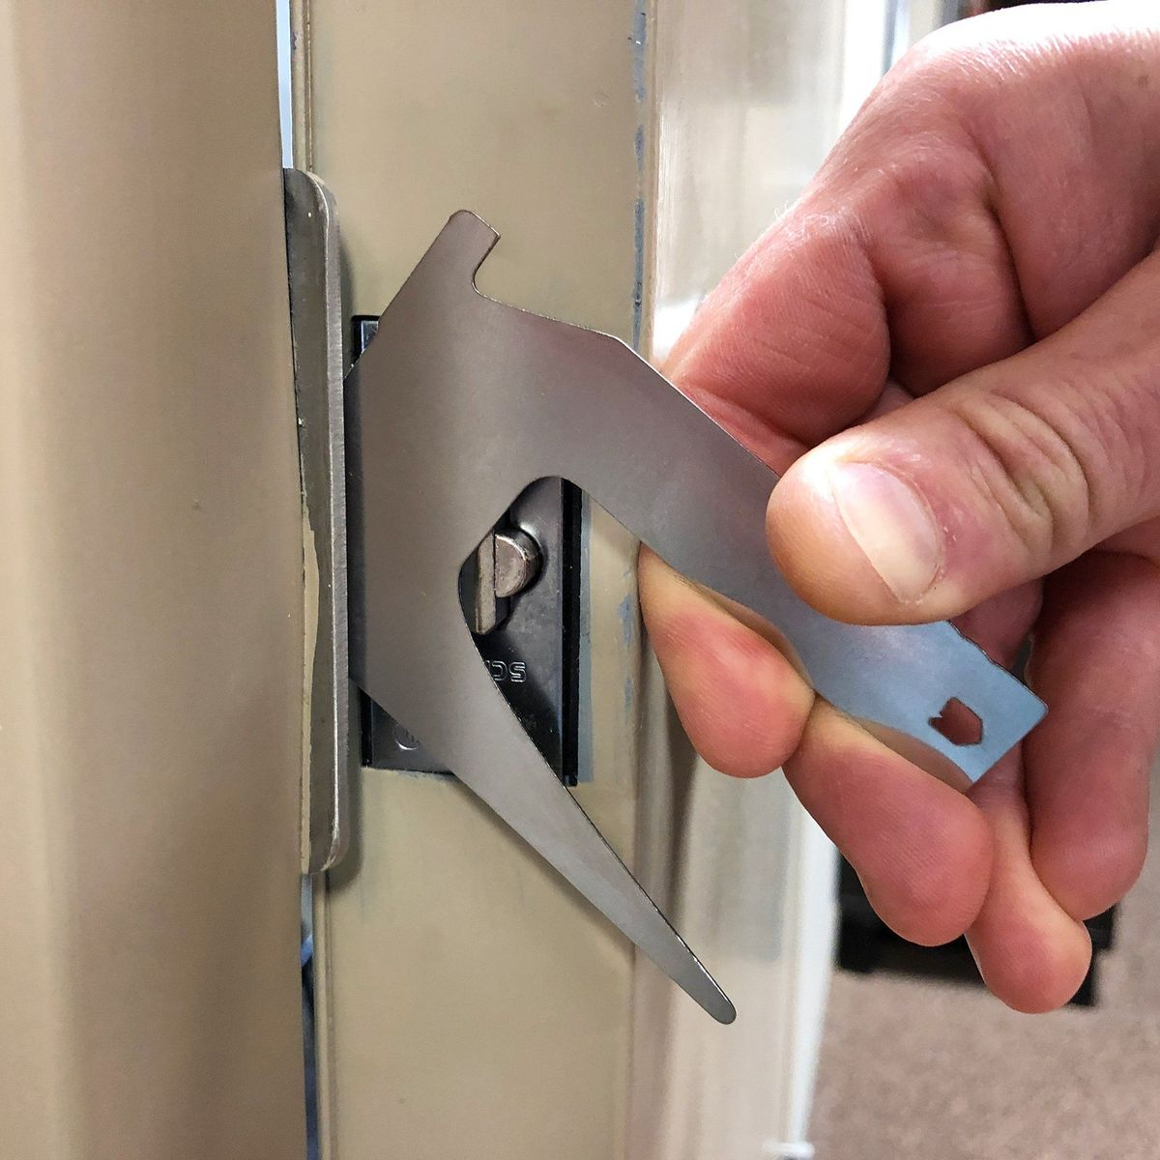
Physical Security: Hacking
While “hacking” is more closely associated with cyber activities, any use of a physical barrier/system in an unintended manner is “hacking”.
Many “hacks” exist for ingresses since businesses (and governments) need to balance the actual intended usage (valid customer or employees justly passing through), with the security risk of malicious actors unauthorized entry.
As an example, the follow slide demonstrates a common commercial door hack that leaves no trace of the unauthorized entry.
ITS First-Strike Latch Bypass Tool.

Slide 13

Physical Security: Door bypass

Slide 14
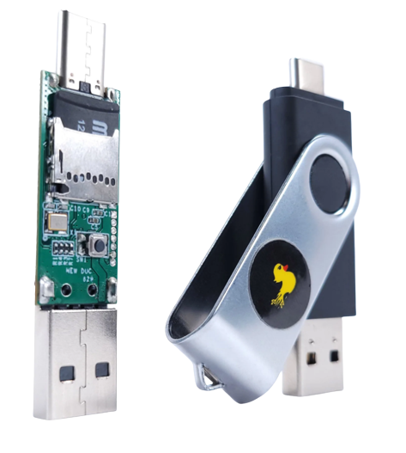
HID attacks: Background
What is HID?
A Human Interface Device.
Examples are USB keyboards/mice/joysticks/touchpads.
What is a HID Attack?
A malicious device that is programmed to act as a keyboard and inject keystrokes.
How is it successful?
HID attacks only require physical access
No special software or zero-day vulnerabilities.
A Hak5 USBA/USBC Rubber Ducky.

Slide 15
HID attacks: Vectors
Data Exfiltration: Stealing sensitive information.
Reverse Shell: Establishing a remote tunnel back to attacks system.
Privilege Escalation: Exploit vulnerabilities or misconfigurations to gain higher privileges on the target system, potentially allowing for full system control.
Credential Theft: Keylogging or executing credential dumping tools to capture user credentials or authentication tokens.
Malware Installation: Old-fashioned malware deployment.

Slide 16
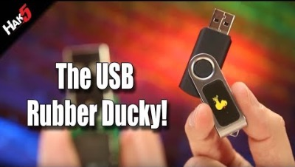
HID attacks: Demonstration

Slide 17

HID attacks: DuckyScript™
A scripting language primarily used for automating keystroke injection attacks.
Simple, platform-independent syntax resembling writing lines of a text file
Executes keystroke commands rapidly
Scriptable payloads deployable via multiple devices
Ideal for penetration testing and automating repetitive tasks
Online IDE: https://payloadstudio.hak5.org
Docs: https://docs.hak5.org/hak5-usb-rubber-ducky/duckyscript-tm-quick-reference Repo of example scripts: https://github.com/hak5/usbrubberducky-payloads

Slide 18
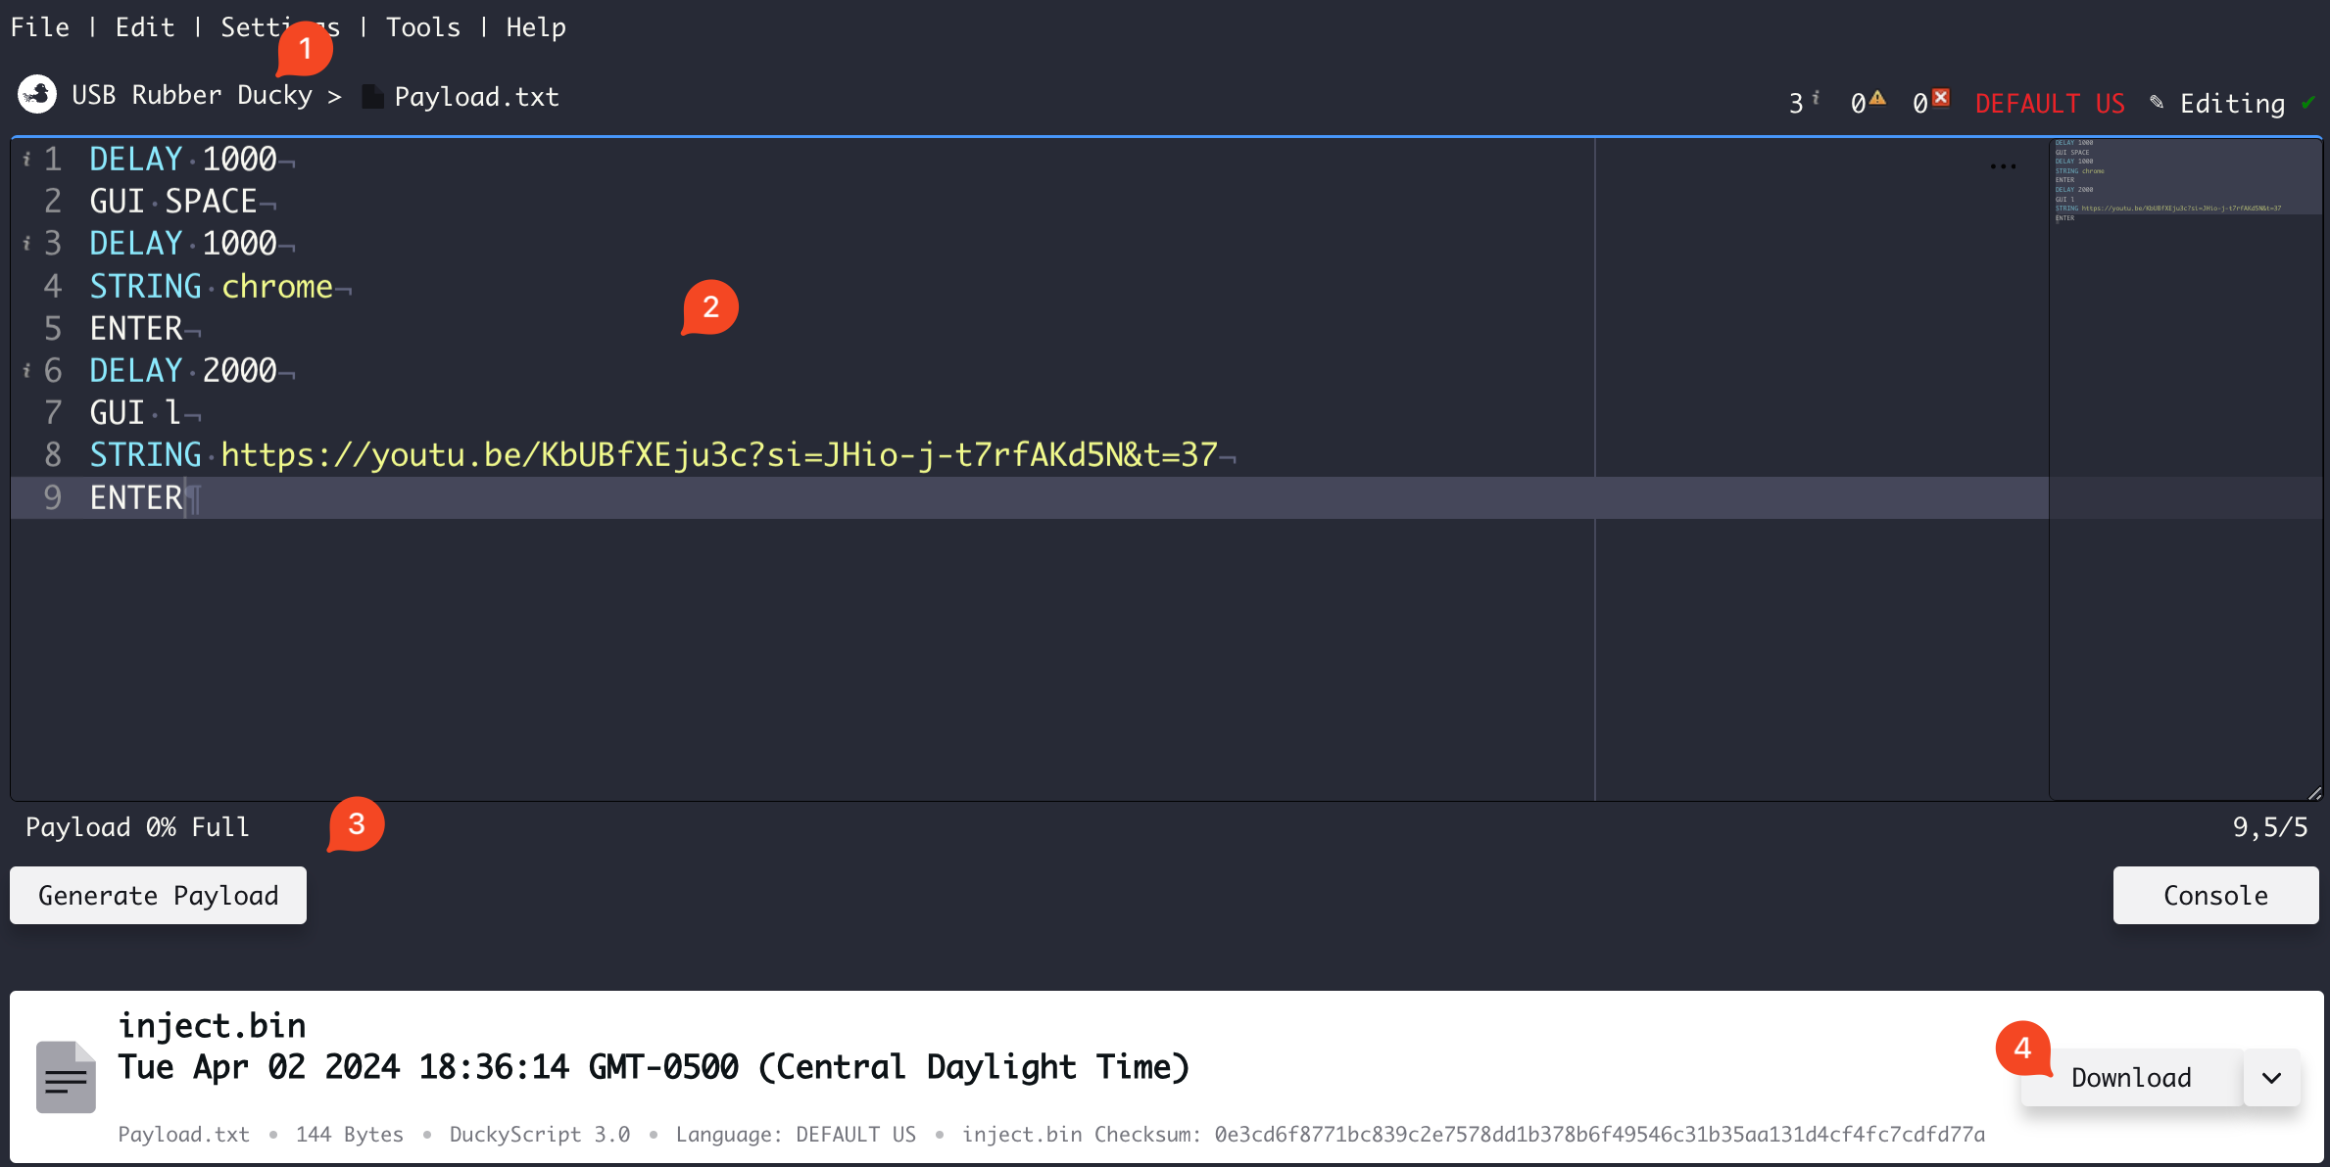
HID attacks: DuckyScript™ example
Device mode
Editor
Generate to bin
Download

Slide 19
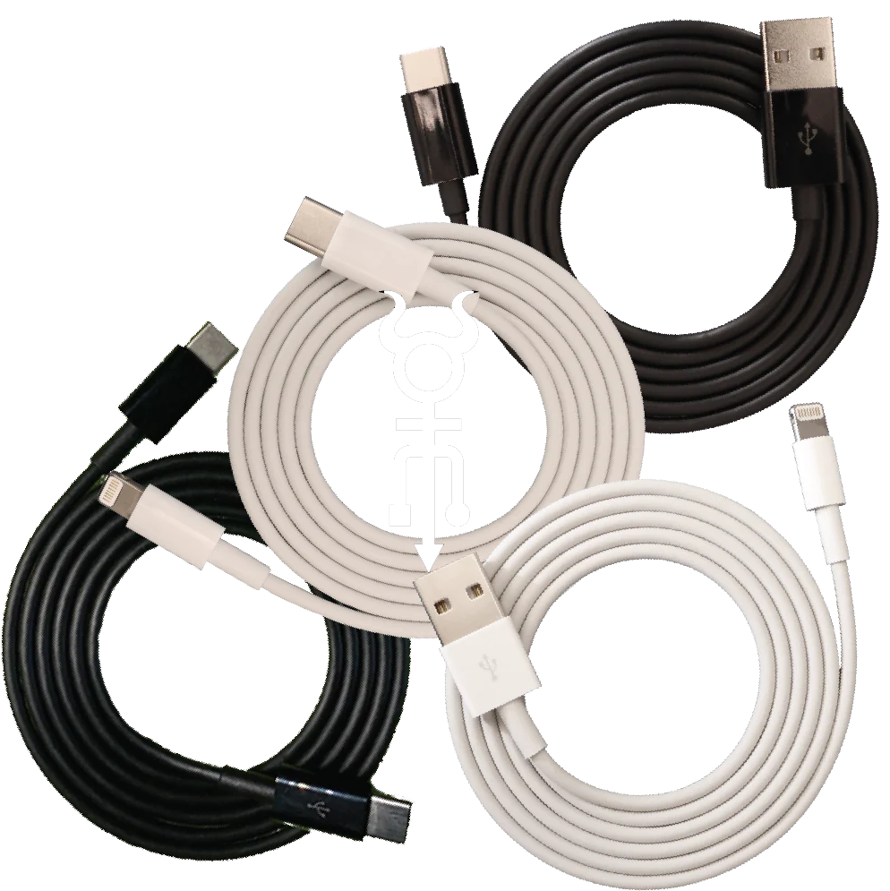
HID attacks: O.MG devices
A USB charging cable that contains:
Flashable EEPROM
Multiple payload slots
Ad-hoc Wi-Fi access point for C²
HID injection and mouse control
… and a keylogger (why not?)
Essentially a commercial version of NSA’s COTTONMOUTH project.

Slide 20
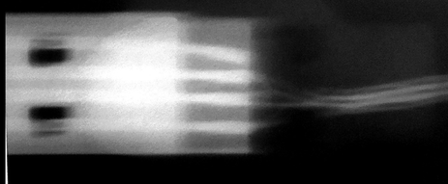
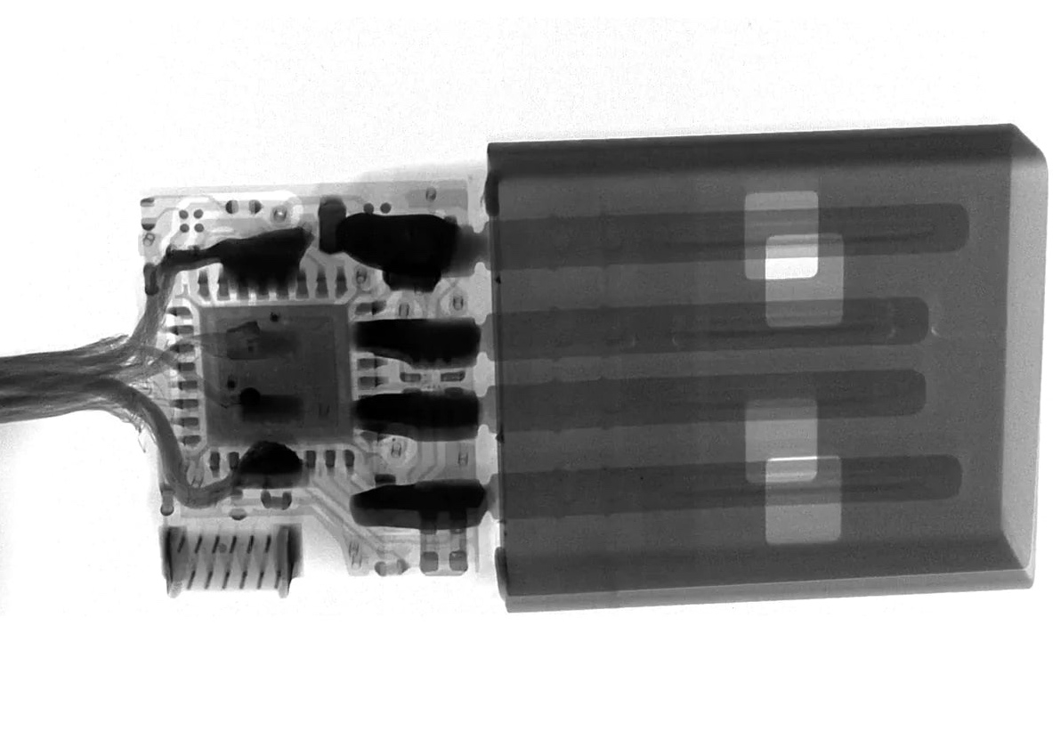
HID attacks: USB cables x-rayed
A “normal” USB A cable with voltage applied.
O.MG USB A implant x-ray.

Slide 21

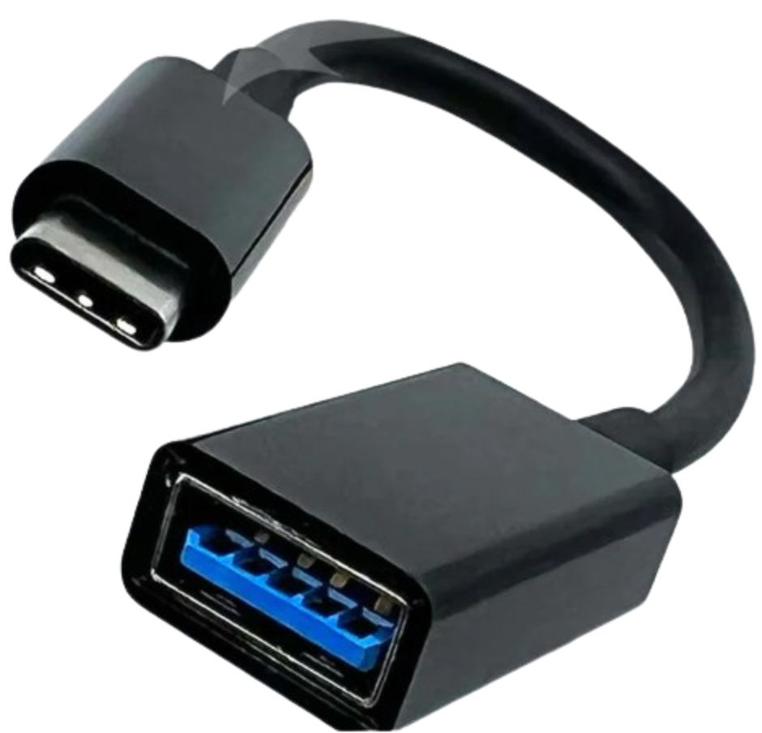
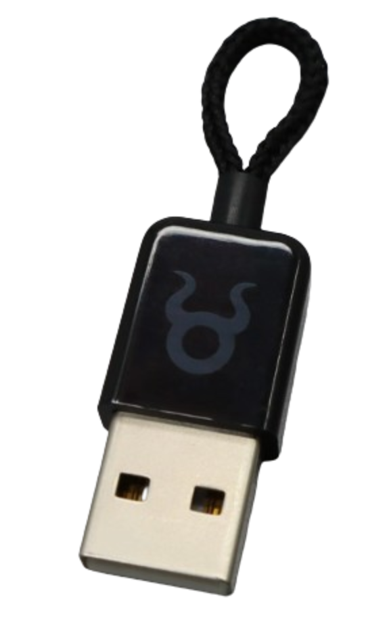
HID attacks: Why stop at cables?
Data “blockers”
USB adapters
Plug
O.MG USB A implant x-ray

Slide 22
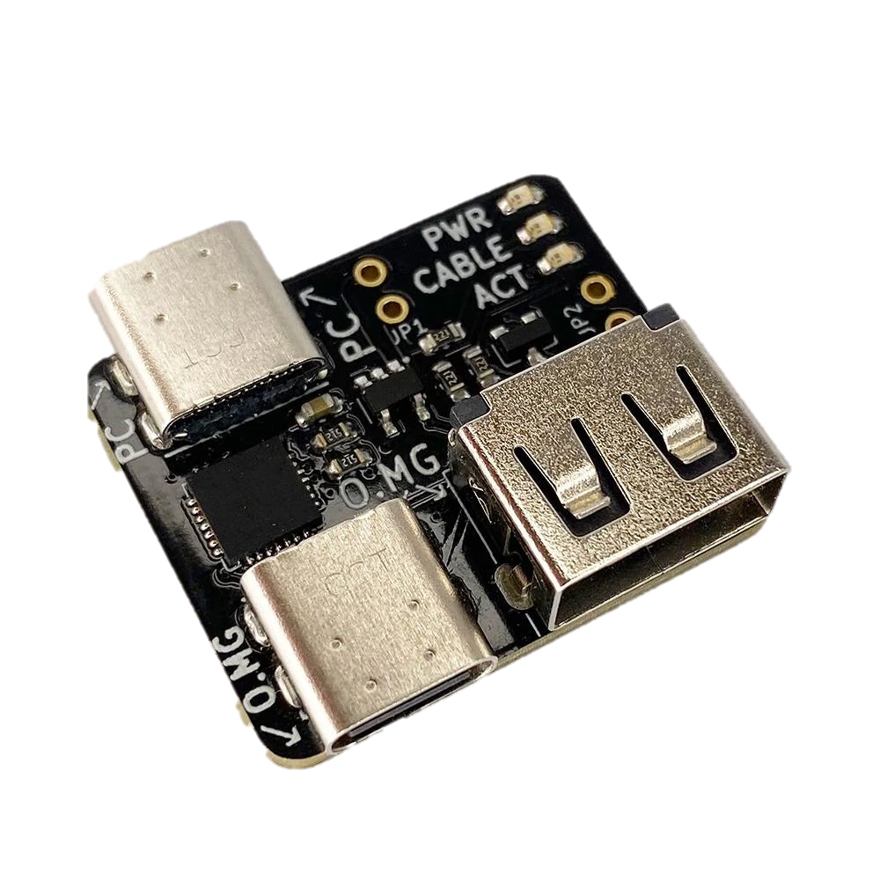
HID attacks: O.MG programming
Same DuckyScript™ as the Rubber Ducky (and other devices) The programmer provides:
Initial O.MG Device setup
Offline firmware upgrades
Recovery from self-destruct
Forensic dumps
Batch firmware install (for bulk deployments)
O.MG USBA/C/Plug Programmer

Slide 23

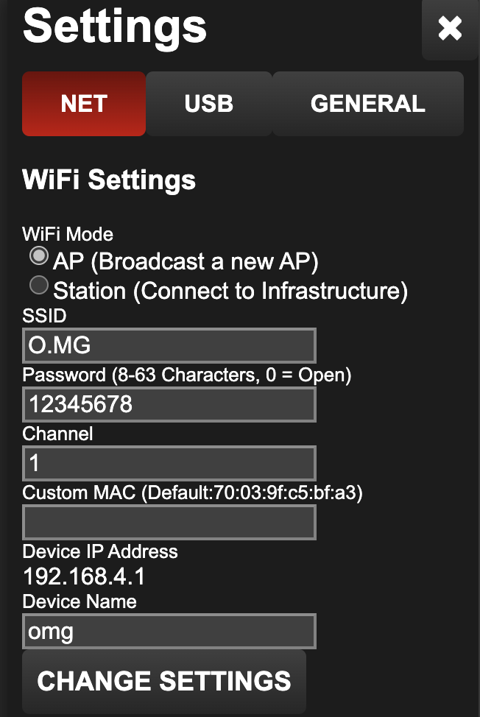
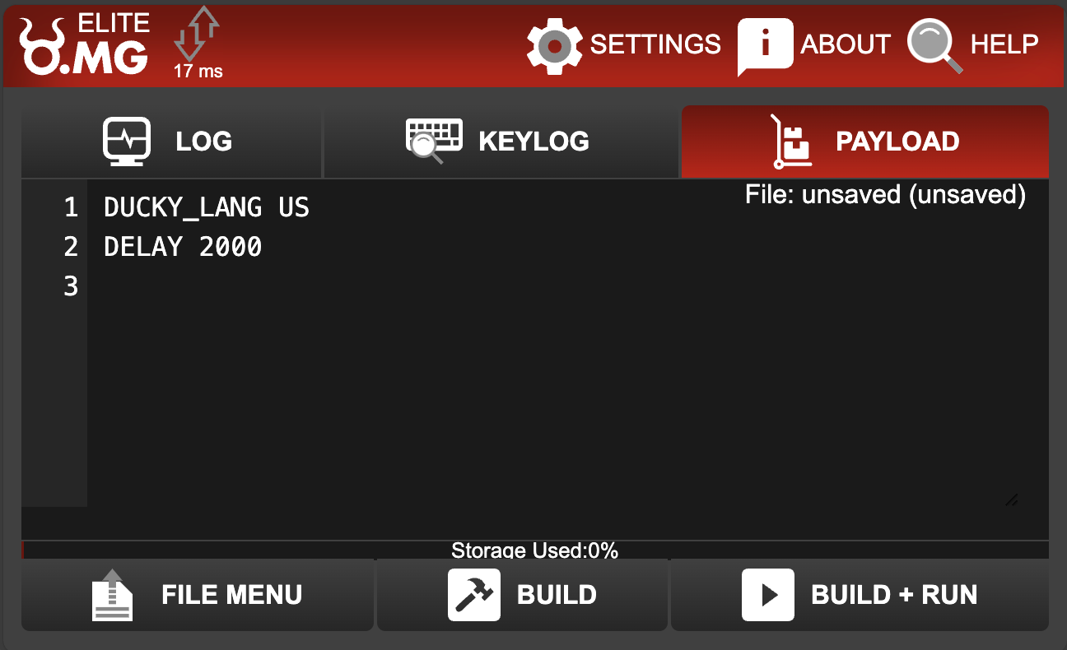
HID attacks: Deployment
Once power is flowing and the cable is booted, a Wi-Fi ad-hoc network will be a broadcast
Visit http://192.168.4.1/ to access the payload IDE and settings

Slide 24
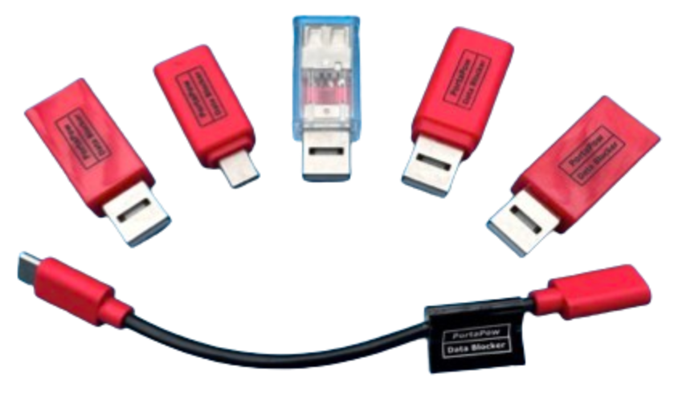
HID attacks: Defense
Disconnects data pins, only allowing 5V charging to pass through.
Blocks pesky data theft
USB A, C and even adapters
In a spectrum of colors because flair
USB “condoms”

Slide 25
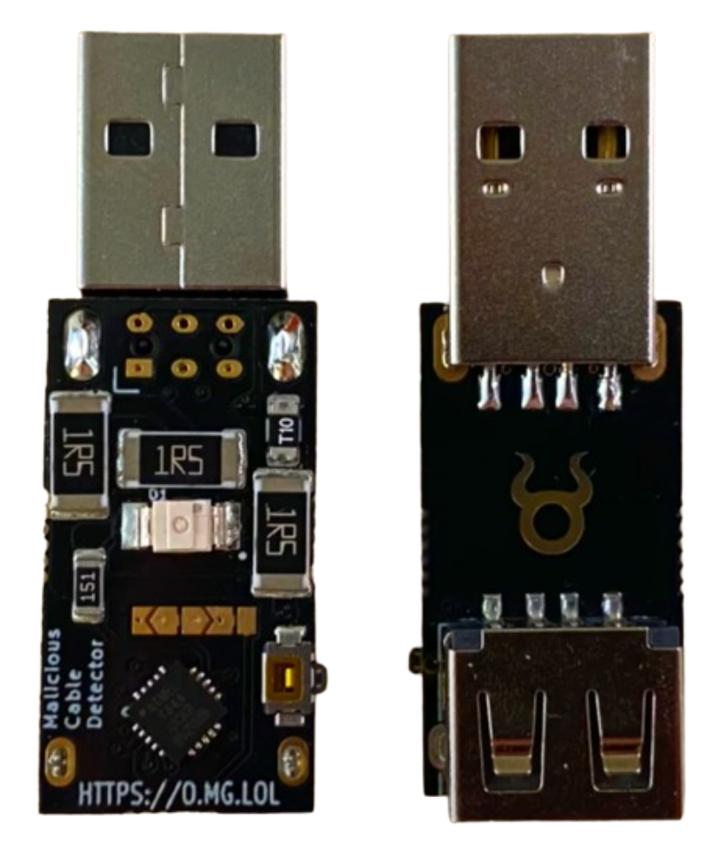
HID attacks: detection
Detects a wide range of malicious cables:
200kHz side channel power analysis detection
Lights up when data sending detected
Easily mod the firmware with Arduino IDE
Malicious cable detector

Slide 26
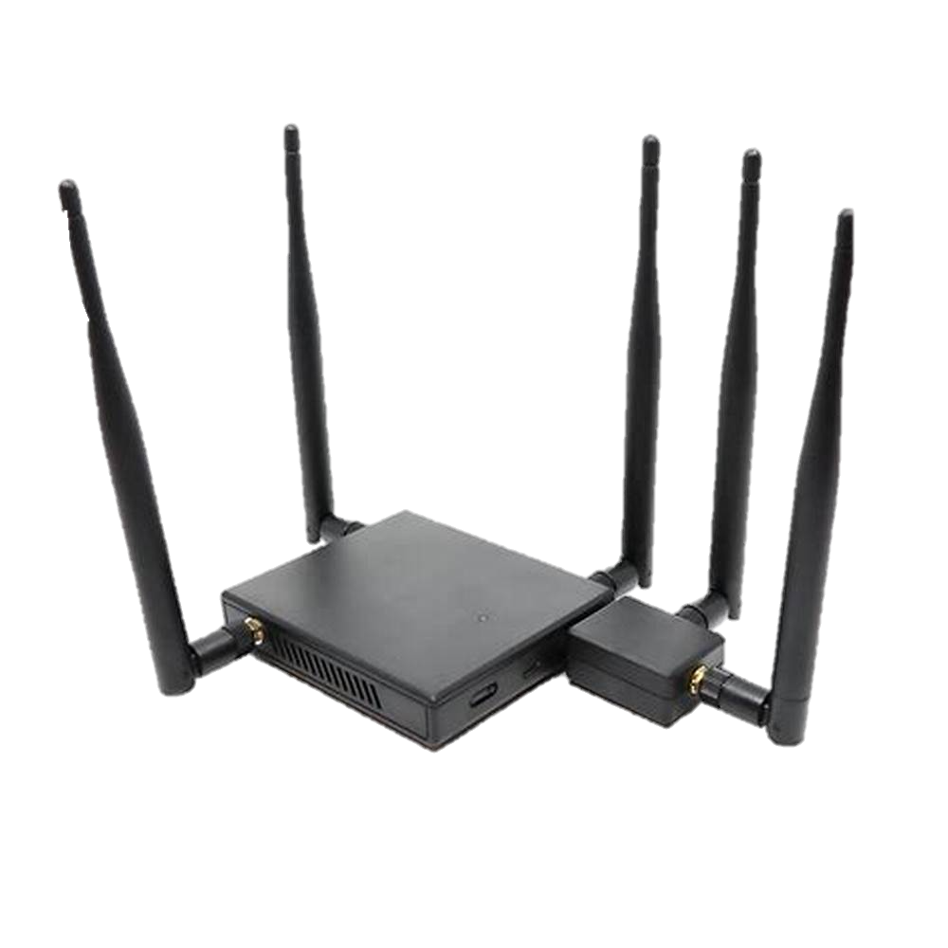
Wi-Fi auditing: Pineapple
Network testing and security tool that can create a “rogue” wireless network.
Simple web interface.
Automated pentesting apps.
Access point suite PineAP.
Multi-radio support: 2.4 GHz & 5 GHz.
Remote access via Cloud C².
Easy peasy credential harvesting through EvilAP.
It’s the reason you don’t connect to unknown Wi-Fi.
Pineapple Mark VII

Slide 27
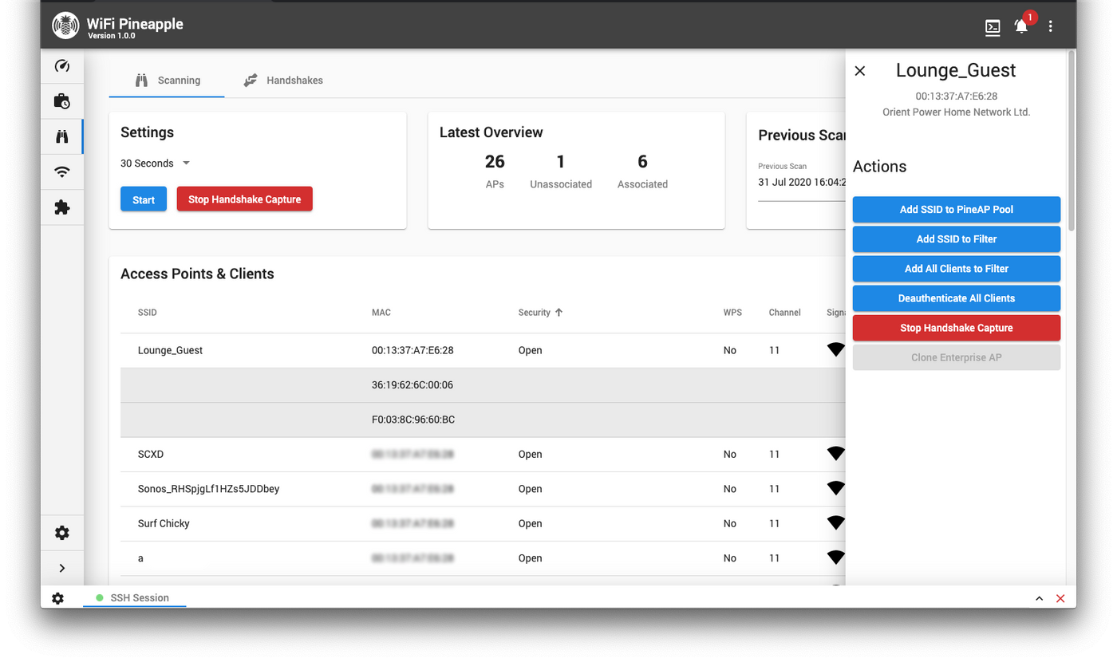
Wi-Fi auditing: PineAP

Slide 28
Questions?

